Slide 1
Handwriting Recognition Using AI
Mikahla Reeves
Florida Agricultural & Mechanical University

Slide 2
Overview
Motivation
Model
Results or what others have found.
Conclusions
Takeaways from the REU Experience

Slide 3
Motivation
Handwritten text recognition is one of key problems studied by the document community due to its pervasiveness in the places where people interact, communicate and transact. HWR technologies can benefit the way we organize and manage information.
We can train the algorithm to recognize characters in a newspaper, store them as text and convert the text to speech.
Handwriting recognition could be language translation.
Handwritten reports such as healthcare and industrial quality control and testing, an instant digital conversion to text will reduce huge costs as well increase productivity.

Slide 4
Challenges
One of the major challenges in recognizing text from handwritten images comes from
The inherent variability in data. Every individual has a different style of writing and moreover, depending on the various underlying factors, even the style of a single person also changes in different instances of writings.
To overcome this challenge deep learning algorithms have been widely used such as
LSTM - Long Short Term Memory
CNN - Convolutional Neural Network

Slide 5
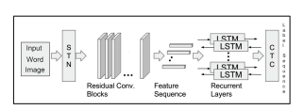
Model
LSTM Model
what is the input of the model
what is the output of the model
what are the operations used in this model

Slide 6
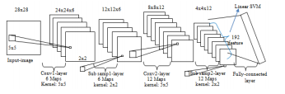
Model
CNN Model
what is the input of the model
what is the output of the model
what are the operations used in this model

Slide 7
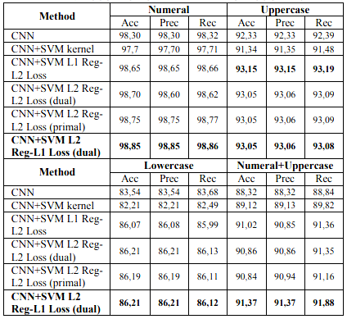
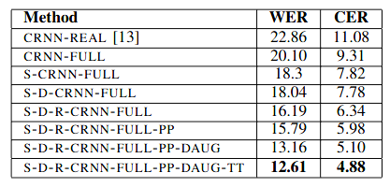
Results
define the metrics used for each model
explain what those metrics mean
right lstm, left cnn

Slide 8
Conclusions
Read papers and see which method is better.
Questions i asked myself when reading...

Slide 9
Takeaways from REU Experience
what i learned and experiences

Slide 10
Acknowledgments
This paper would not have been possible without the exceptional support of Gregor von Laszewski, Carlos Theran, Yohn Jairo.
Their constant guidance, enthusiasm, knowledge and encouragement have been a huge motivation to keep going and to complete this work.
Thank you to Jacques Fleicher, for always making himself available to answer questions. Finally, thank you to Byron Greene
and the Florida A&M University for providing this great opportunity for undergraduate students to do research.

